Slide 1

Big Data Architecture
Max Darby
DARBYM1@TCD.ie

Slide 2
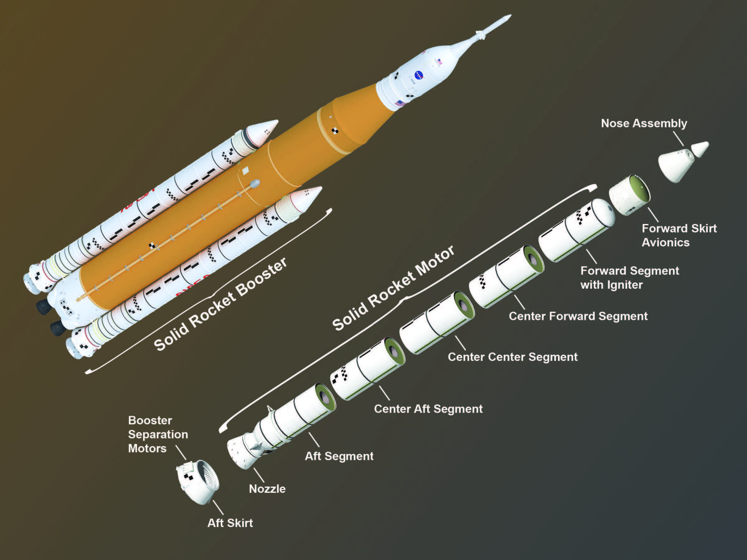


Slide 3
Data Strategy
Overview
Technology considerations (Data Architecture – how will data move?)
Security and Governance (Data Fabric and Data Mesh)
Analytics operating model (Information Architecture – how will information move?)
Data professionals: their roles and responsibilities.
Upskilling plan & data literacy (Data Academies)

Slide 4
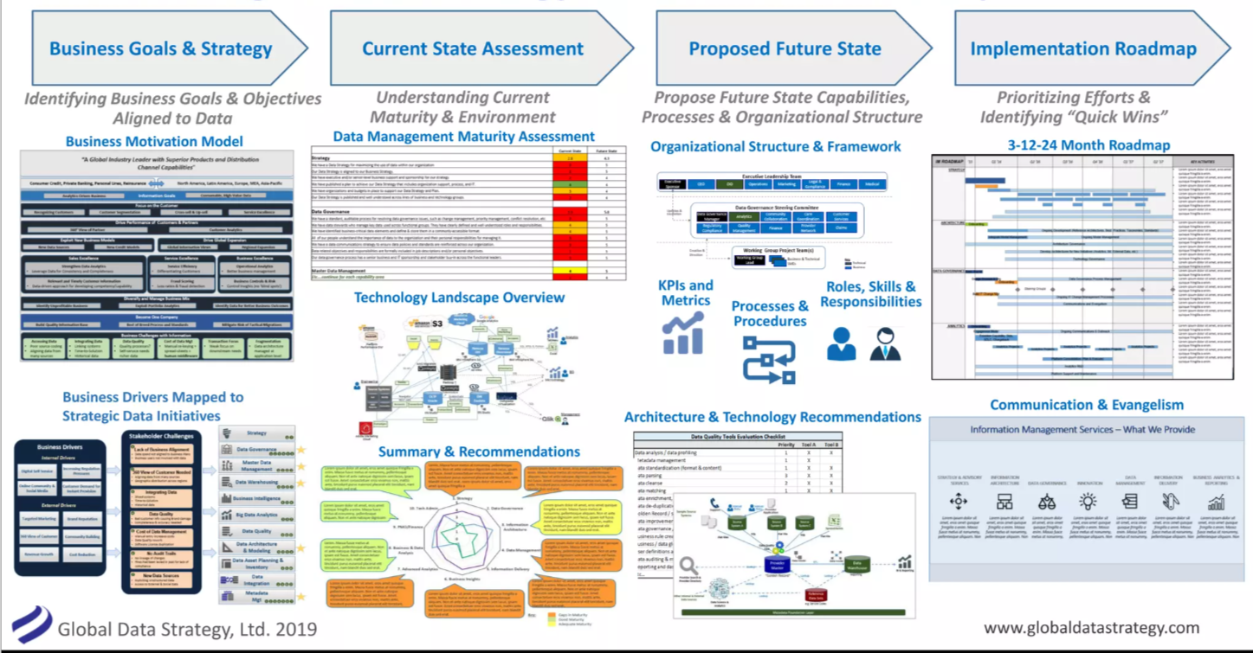
Building a data strategy
Notes:
Need to think of it as a strategy to get from raw data to business decisions/value. You need both before starting, and starting from each end will dictate the structure.
i.e., the data will dictate the technology, the tech will dictate the people you need, the people & tech will dictate the analytics approach, the analytics approach will dictate the tools, etc.

Slide 5
data strategy
Data Sources & Discovery
Data Ingestion
Storage
Analytics/Reporting
Layer
Business Functions (Consumption)
Business Objectives
Data Literacy
Analytic operating model
AI Layer
Data Management Layer (Governance & Security)
Notes:
Business goals/objectives – Decide whether Defensive | Offensive or mix.

Slide 6
data strategy
Data Sources & Discovery
Data Ingestion
Storage
Analytics/Reporting
Layer
Business Functions (Consumption)
Business Objectives
Data Literacy
Analytic operating model
AI Layer
Data Management Layer (Governance & Security)
Notes:
Business goals/objectives – Decide whether Defensive | Offensive or mix.

Slide 7










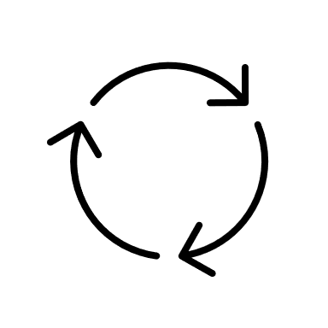


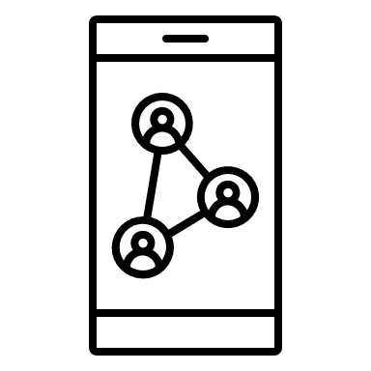



data strategy
Data Sources & Discovery
Data Ingestion
Storage
Structured
Batched
RDB
DWH / Data Mart
Analytics/Reporting
Layer
Business Functions (Consumption)
Business Objectives
Data Literacy
HADOOP
Semi-Structured
Analytic operating model
CLOUD
Stream
ON-PREM
AI Layer
Unstructured
HYBRID
Data Management Layer (Governance & Security)
Notes:
Business goals/objectives – Decide whether Defensive | Offensive or mix.

Slide 8

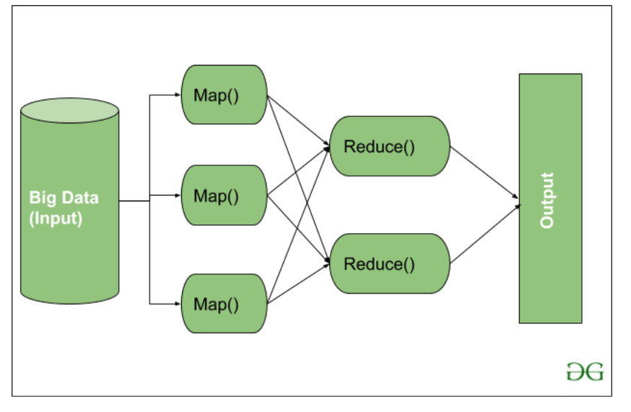
Deepdive on Big data technology: Hadoop
Think about REALLY big data. Files/feeds bigger than you are able to store on a single computer/server.
Main benefit is turning large unstructured data into manageable structured data, through map & reduce.
Distributed computing and storage.
Open source
Emerging Alternatives
Google Cloud BigQuery.
Databricks Lakehouse Platform.
Cloudera.
Hortonworks Data Platform.
Snowflake.
Google Cloud Dataproc.
Microsoft SQL Server.
Notes:
Useful guide to Hadoop: https://www.projectpro.io/article/hadoop-explained-how-does-hadoop-work-and-how-to-use-it/237

Slide 9
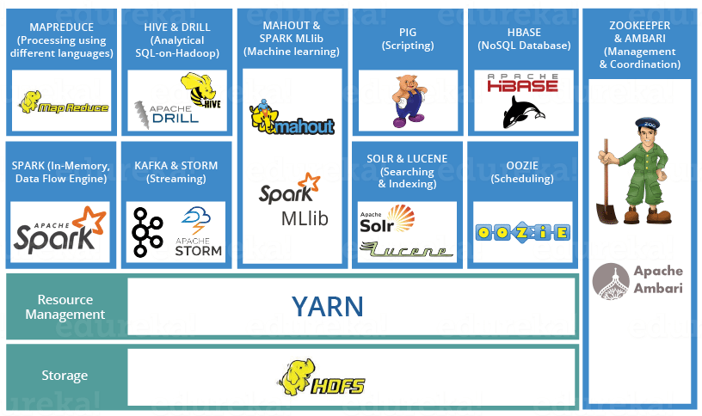

Slide 10
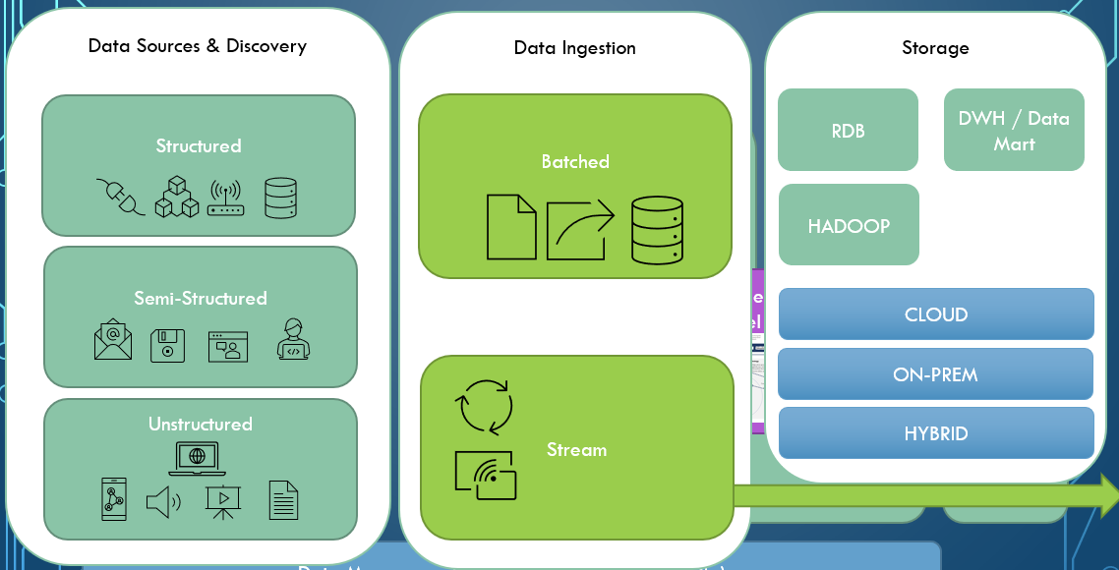
data strategy
Data Sources & Discovery
Data Ingestion
Storage
Analytics/Reporting
Layer
Business Functions (Consumption)
Business Objectives
Data Literacy
Analytic operating model
AI Layer
Data Management Layer (Governance & Security)
Notes:
Business goals/objectives – Decide whether Defensive | Offensive or mix.

Slide 11


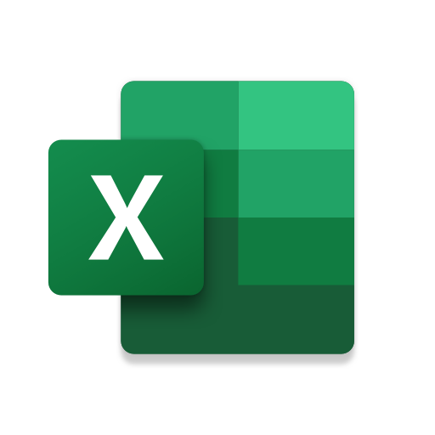


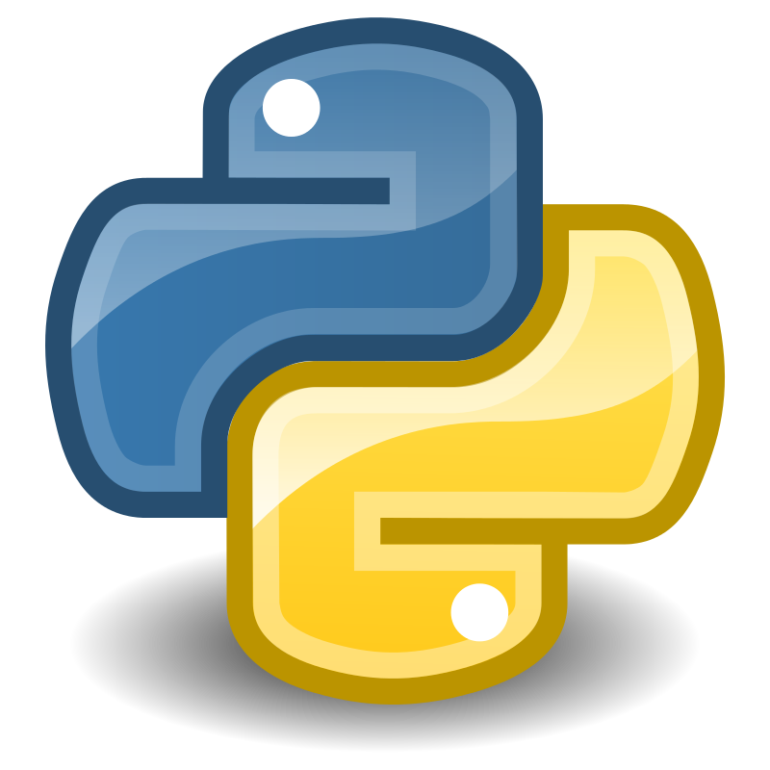
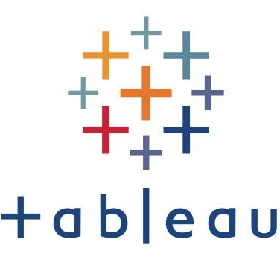
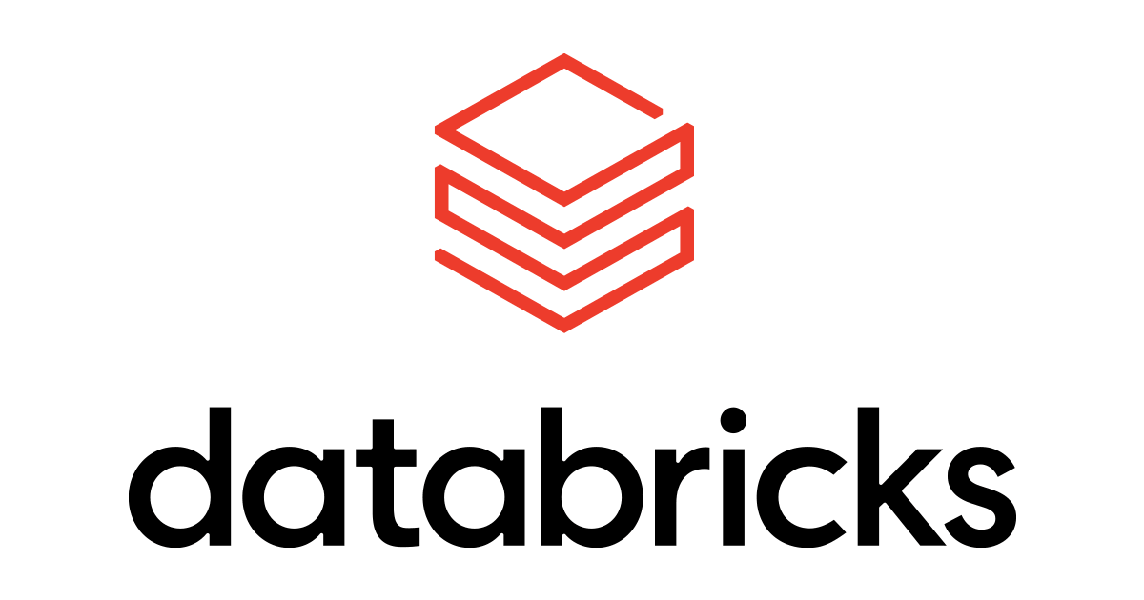

data strategy
Analytics/Reporting
Layer
Data Sources & Discovery
Data Ingestion
Storage
Business Objectives
Business Functions (Consumption)
Data Literacy
Making data meaningful in context of the business.
Converting data from tables to meaningful output.
Mixture of automated and manual processes.
Decentralised or centralised.
Ad hoc, POC/POV, productionised workflows.
(Un)documented
Highly aligned with business objectives
Analytic operating model
AI Layer
Custom dashboards/reports
(Automated or Manual)
Platform reporting
Internal application front-ends
Data Management Layer (Governance & Security)
Notes:
Business goals/objectives – Decide whether Defensive | Offensive or mix.

Slide 12
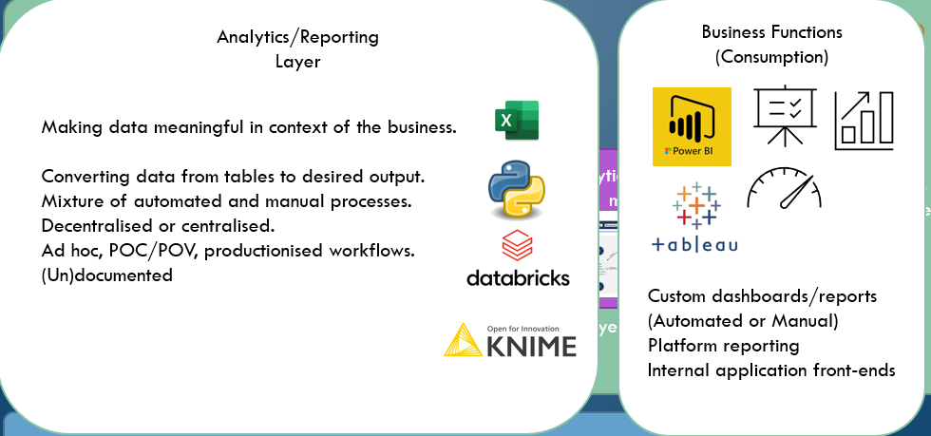
data strategy
Data Sources & Discovery
Data Ingestion
Storage
Analytics/Reporting
Layer
Business Functions (Consumption)
Business Objectives
Data Literacy
Analytic operating model
AI Layer
Data Management Layer (Governance & Security)
Notes:
Business goals/objectives – Decide whether Defensive | Offensive or mix.

Slide 13
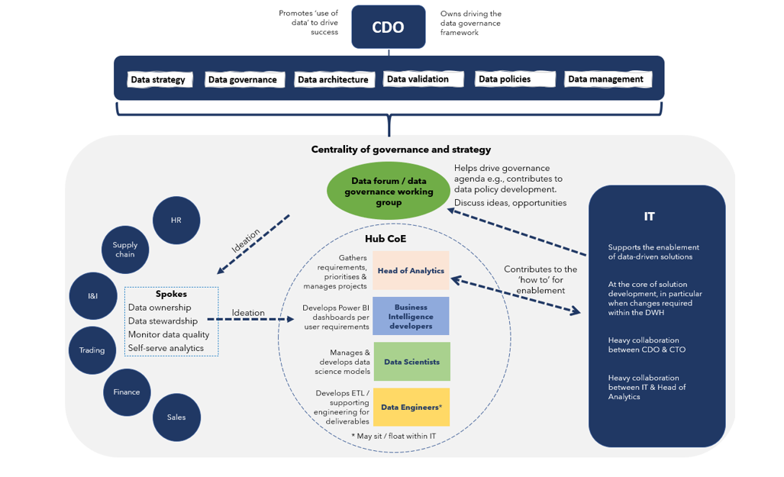
data strategy
Analytics operating model
Data Sources & Discovery
Data Ingestion
Storage
Analytics/Reporting
Layer
Business Functions (Consumption)
Business Objectives
Data Literacy
Types
Centralised
Decentralised
Specialised Hybrid Model (Hub & Spoke)
AI Layer
Data Management Layer (Governance & Security)
Notes:
Business goals/objectives – Decide whether Defensive | Offensive or mix.

Slide 14
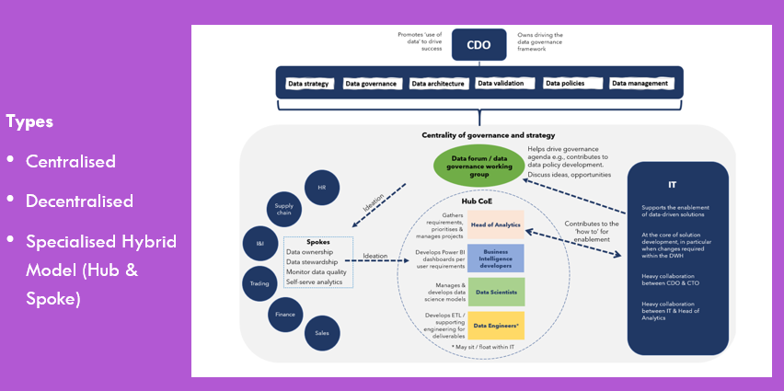
data strategy
Data Sources & Discovery
Data Ingestion
Storage
Analytics/Reporting
Layer
Business Functions (Consumption)
Business Objectives
Data Literacy
Analytic operating model
AI Layer
Data Management Layer (Governance & Security)
Notes:
Business goals/objectives – Decide whether Defensive | Offensive or mix.

Slide 15
data strategy
Data Management Layer (Governance & Security)
Accuracy/Validation
Is the data in the table correct?
Completeness, consistency, timeliness, validity, uniqueness.
Observability
Ability to monitor above accuracy measures.
Data relationships and data lineage
What data can(not) be used together?
Data dictionary: Technical and enterprise metadata.
Have we agreed what this data means? (e.g., what is our definition of ‘margin’ or ‘profitability’?).
Ranking/scoring: how do we prioritise certain data, based on usage/accuracy/helpfulness.
Discovery
Whose job is it to identifying new data – and what do they do when they have?
Data certification/compliance
What criteria does our data need to meet in order to be lawful?
Ownership
Who owns data accuracy/compliance/metadata?
Data Sources & Discovery
Data Ingestion
Storage
Analytics/Reporting
Layer
Business Functions (Consumption)
Business Objectives
Data Literacy
Analytic operating model
AI Layer
Notes:
Business goals/objectives – Decide whether Defensive | Offensive or mix.

Slide 16
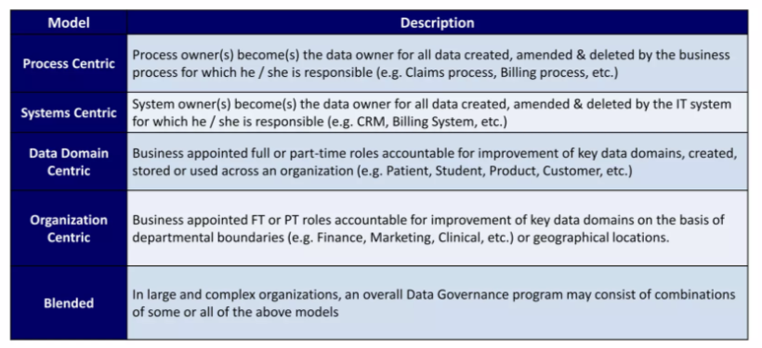
Governance: Ownership

Slide 17
Tools to help with Governance
Data Fabric
Data Mesh
“Data fabric … continuously identifies and connects data from disparate applications to discover unique, business-relevant relationships between the available data points.” - Gartner
A data fabric ensures different domain-specific data can link together, in order to create a more rounded view of the business.
It does this by curating knowledge graphs of data sources, using metadata, and is often embedded at the data catalogue stage.
Decentralisation of data, but with a centralised governance. Focus on business team needs and domain-level ownership first, then technology.
Complimented by a data fabric. Fabric makes sure all the data is cohesive, mesh makes sure the data is with the people who need it – not hidden in a monolithic centralised data warehouse where nobody can find it.
Notes:
Data fabric: https://www.gartner.com/smarterwithgartner/data-fabric-architecture-is-key-to-modernizing-data-management-and-integration
https://www.ibm.com/topics/data-fabric
- Good framework from Forrester: 6 main points
Data Management layer: This is responsible for data governance and security of data.
Data Ingestion Layer: This layer begins to stitch cloud data together, finding connections between structured and unstructured data.
Data Processing: The data processing layer refines the data to ensure that only relevant data is surfaced for data extraction.
Data Orchestration: This critical layer conducts some of the most important jobs for the data fabric—transforming, integrating, and cleansing the data, making it usable for teams across the business.
Data Discovery: This layer surfaces new opportunities to integrate disparate data sources. For example, it might find ways to connect data in a supply chain data mart and customer relationship management data system, enabling new opportunities for product offers to clients or ways to improve customer satisfaction.
Data Access: This layer allows for the consumption of data, ensuring the right permissions for certain teams to comply with government regulations. Additionally, this layer helps surface relevant data through the use of dashboards and other data visualization tools.
Data Mesh:
https://martinfowler.com/articles/data-monolith-to-mesh.html

Slide 18
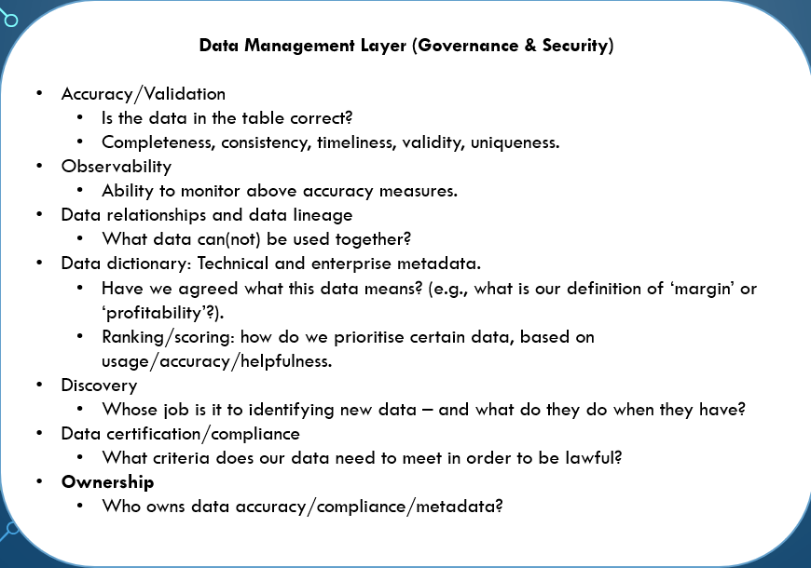
data strategy
Data Sources & Discovery
Data Ingestion
Storage
Analytics/Reporting
Layer
Business Functions (Consumption)
Business Objectives
Data Literacy
Analytic operating model
AI Layer
Data Management Layer (Governance & Security)
Notes:
Business goals/objectives – Decide whether Defensive | Offensive or mix.

Slide 19
Data professionals
Business
BI / Data Analyst
Build reports
Answers analytical questions from the business
Data Scientist
Builds models
Experiments with business processes & optimises
Data Engineer
Build systems that collect & store data
Build infrastructure around ML/AI models built by DS
Data (Cloud) Architect
Defines the policies, procedures, models and technologies to be used in collecting, organizing, storing and accessing data
Analytics
IT

Slide 20
Data literacy – upskilling and democratising data
It’s important to learn data-communication across all levels of expertise.
Data is only useful if it is understood – data dictionaries help, but realistically it’s like another language (especially visually). It’s important to make sure everyone that uses data is understanding what they’re reading.
Data owners help – they should be SMEs in their respective areas.
For larger companies, running a Data Academy can be a viable option.
Notes:
(why I’ll be asking for diagrams in the first assignment!)

Slide 21
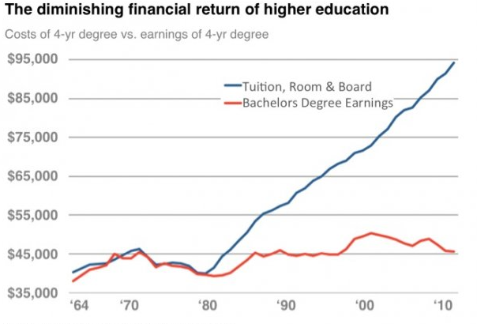


Think about the non-data professional consumers
And even tougher when you start talking about probabilities..
For example, the Monty Hall problem
Notes:
read the chart without taking into account a key fact that wasn’t on the chart: the cost of not going to college has diminished even more.
Than means, your prospects as a high school graduate are a lot worse than your prospects as a college graduate.
Another key piece of information is on the chart itself. Note the average yearly income a college grad can expect is about $45,000 in 2010. That’s per year. Over an average working lifetime (say, 43 years assuming retirement at age 65), that gives you an income of $45,000 * 43 = $1,935,000. Subtract that expensive college education ($95,000) and your net earnings are $1,840,000. Compare that to your average high school grad. They can expect to earn $1,300,000 over their lifetime (635k less – pretty good return for a 95k investment)

Slide 23
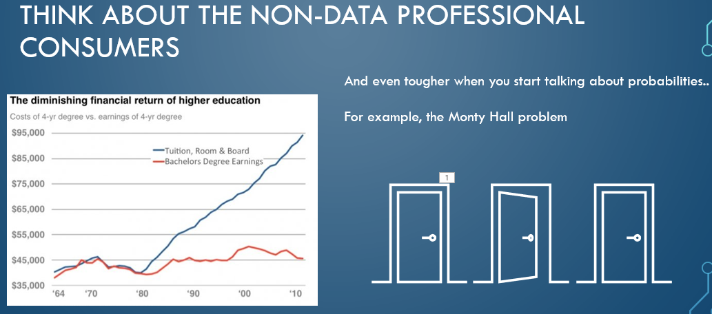
data strategy
Data Sources & Discovery
Data Ingestion
Storage
Analytics/Reporting
Layer
Business Functions (Consumption)
Business Objectives
Data Literacy
Analytic operating model
AI Layer
Data Management Layer (Governance & Security)
Notes:
Business goals/objectives – Decide whether Defensive | Offensive or mix.

Slide 24
Summary: Think ahead … very far ahead if you can
Notes:
“ancient horses’ asses control almost everything, and current horses’ asses are controlling everything else.”

Slide 25

Assignment 1: Build a data strategy for company x
5000 word-count limit
Create diagrams to illustrate your plans and how they link together.
Visio (edu licence), Lucid chart, draw.io, etc.
In your write-up please evaluate why you made the choices you did, as a group.
I am aware that there is a lack of literature in this area (some of the concepts we have discussed only emerged in the last few months). Hence, an increased emphasis on documenting what you did and the reasoning for it. Demonstrate your ability to think critically.
If you don’t explain that you thought about it, I will assume you didn’t.
Any citation is acceptable, provided it is consistent. If in doubt, use APA.
I would highly recommend using a Citation Manager (Zotero, Mendeley..)

Slide 26
Getting started
Focus on what the business does first. Think about their needs, and what they might do next. Think about what needs to be controlled and what might need to be flexible.
Think about what kind of business functions would support those objectives, and how they might be organised – would they have their own systems/analysts or look to a centralised team? What would the benefits of either be?
What data would they need? Where could they make use of big data?
What technology would you need to support that data?
What would you do to bring that technology to the company and help the business accept/understand it?
What procedures would you put in place to make sure it’s all running correctly, and into the future?

Slide 27
